Slide 1
HINT
Deploying Sensitive AI Workflows Using Trial-And-Error Programming
Professor: Abhilash Jindal
Final Presentation of Vishal Singh 2018CS50426. Course COD891 Minor Project
Notes:
Is my screen shared ?
Good Afternoon everyone
I will be presenting the HINT Framework that helps in Deploying Sensitive AI Workflows Using Trial-And-Error Programming
I am working under prog Abhilash Jindal

Slide 2
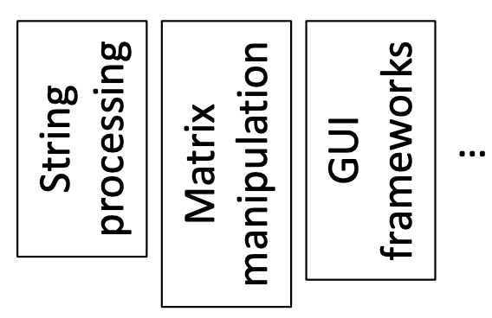
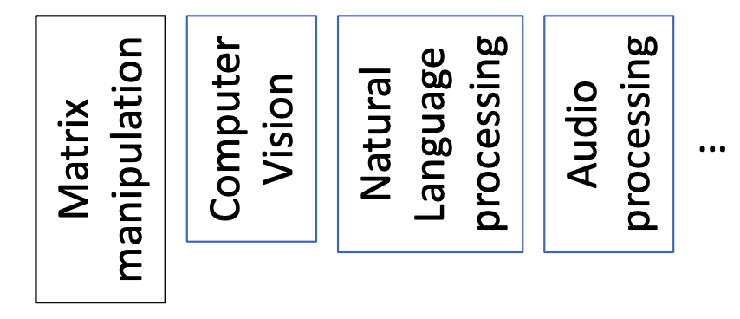
Traditional application development
Flaky workflow development
Reliable building blocks
sort([3,4,2]) -> [2,3,4]
reverse(“HINT”) -> “TNIH”
set_color(“#1eb4e9”)
Flaky building blocks:
ocr(“doc.png”) -> [“H1NT: Deploying..”, 0.90]
semantic(“App doesn’t work. Frustrating!”) -> [-0.6, 0.90]
caption(“surf.jpeg”) -> [“man riding a bike”, 0.96]
Modern ML workflow development fundamentally differs from application development because the workflow building blocks are flaky.
Notes:
I will give quick introduction and motivation for the project who are seeing it the first time.
Sort is well defined. You take a input list and sort it depending on a function.
In sort, input-output relationships remain stable across library versions.
In contrast, modern workflows are built on top of flaky building blocks which cannot generate 100% accuracy.
They provide confidence levels. But you to incorporate confidence levels in ml workflows ?

Slide 3
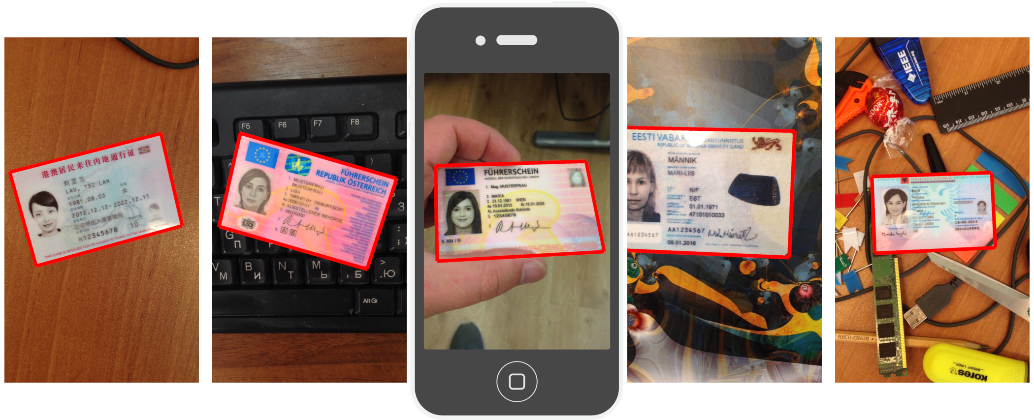

Reasons for flow flakiness
Unseen input variations
Rotated, skewed, blurred, torn or glued pages
Poor lighting, reflection and shadows on pages
50 US states with some updating licenses every year. New format may be work well with extractor
Flow may not expect renter lease agreement as a valid address proof.
Handwritten text not working well
Notes:
In production, flows commonly see input variations not observed at the time of development

Slide 4
Reasons for flow flakiness (2)
2. Model errors
Model accuracy: OCR engines making mistakes. Recognize 4 as 9 and o as 0 etc.
Model bias: Overfit Problem
Semantic errors: Output may be semantically incorrect. Generating name as “Tata Motors” from income proof
Notes:
Model accuracy: For some fields like salary fields, we can improve performance by forcing all characters as digits but still errors are possible.

Slide 5
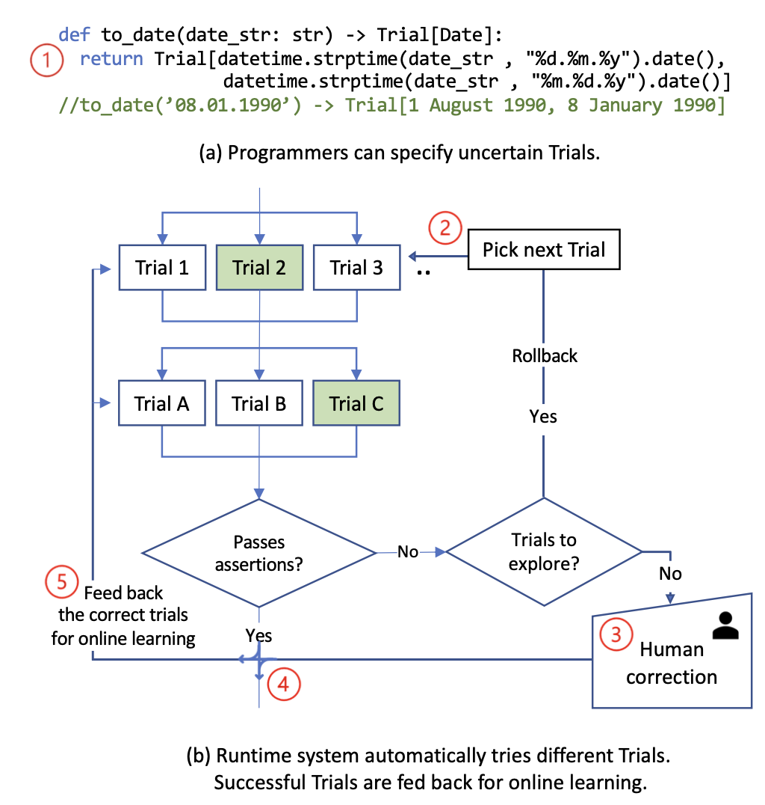
Programming Model
Trial-and-error programming
Associated runtime where the programmers are not burdened with actively correcting this flakiness
Notes:
Human interruption is less over here

Slide 6
Programming Model (2)
Describing correctness
Specify constraints/checks/assertions that intermediate states are expected to meet
Examples:
Verify typing information (e.g. output is integer)
Verify model confidence levels
date of issue >= date of birth + 18 years
Also check for extracted data validation in a third party database
Notes:
These checks are simply assertions
Examples of these checks
External checks: social security number can be queried in third-party or first-party databases to check if provided information matches

Slide 7
Programming Model (3)
Describing uncertainty
Eager Trial: All possibilities are immediately available
01.08.1990 can be understood as 1 August 1990 or as 8 January 1990
top-K results of ML models
Lazy Trial: Alternative possibilities may be provided lazily
Trying different ML Models
Microsoft Form Recognizer API, Google Document AI, and Amazon Textract
Notes:
top-K results of ML models can be formulated as eager trials
We are not making all the output possibilities immediately available. We just say try different models and then give the output.

Slide 8
Assumption for Rollback Computation
Rollback to previous state in general is hard
General purpose rollback mechanisms have prohibitively high overheads
Side-effects such as system calls (write to disk etc)
Distributed computing frameworks such as MapReduce, Dryad and Spark assume that all tasks in execution graph are both deterministic and stateless
With that assumption, rollback becomes easy
Notes:
We are now taking about rolling back the execution graph of the workflow

Slide 9
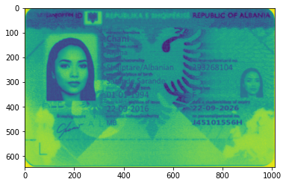

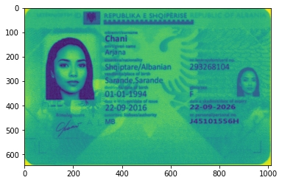
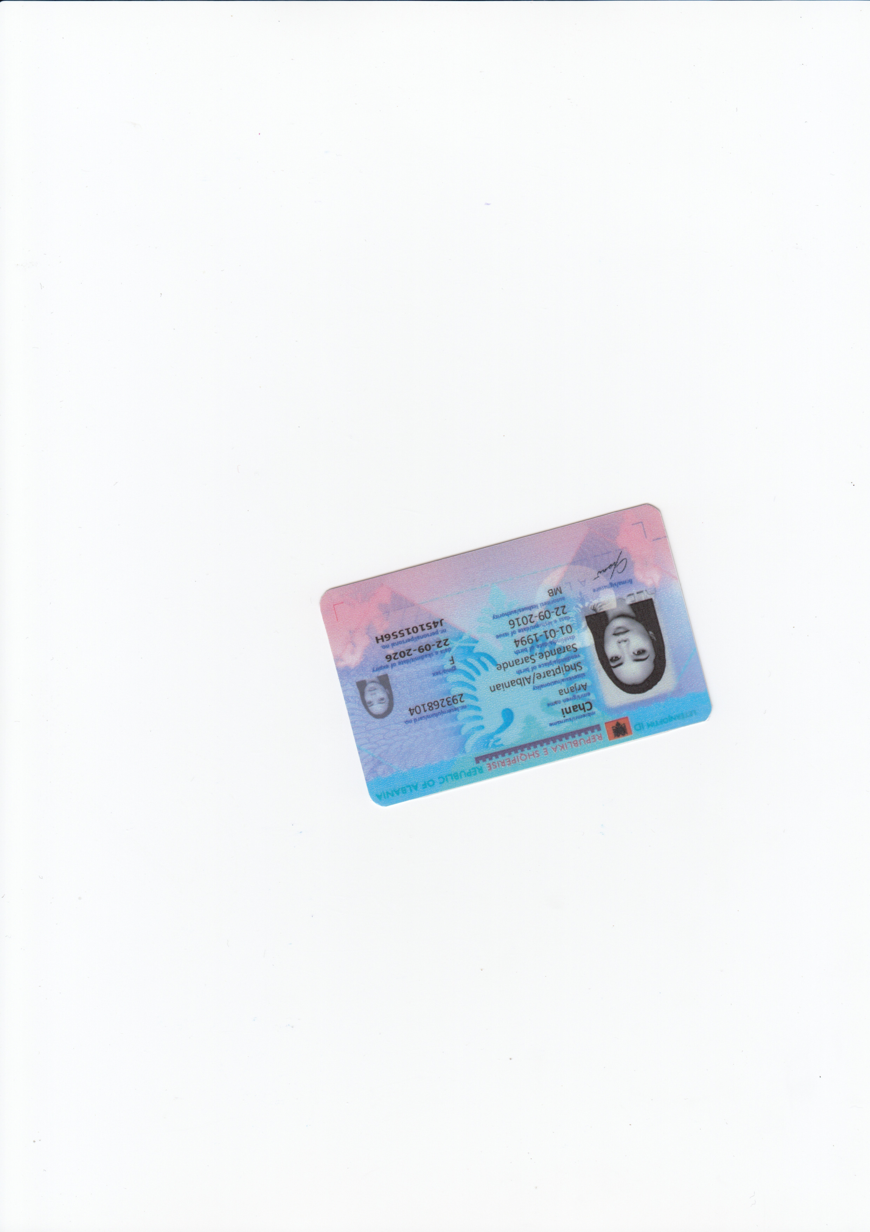
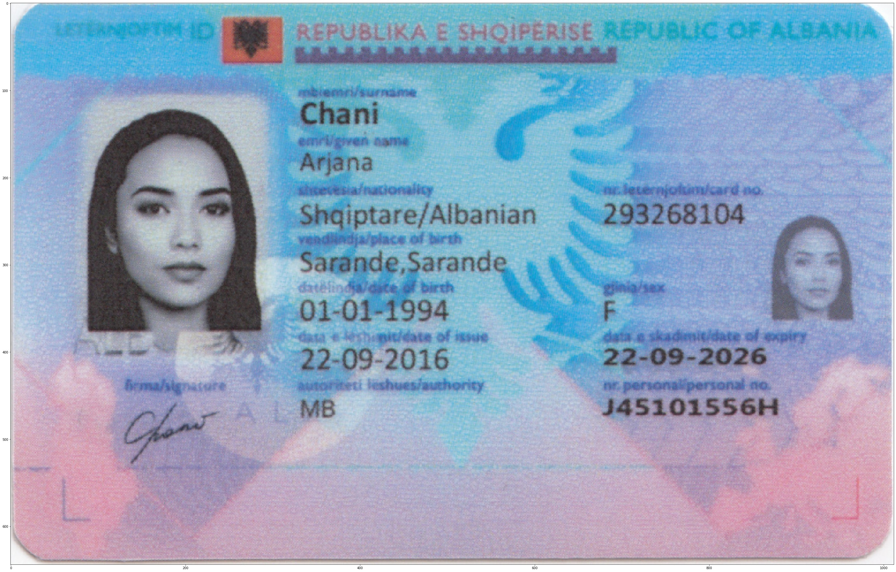
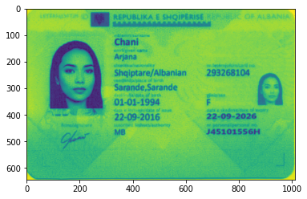
Card Processing Workflow
Trials
Trials
1. EasyOCR
2. Tesseract OCR
Trials
Channel Picker
Confidence: 0.79
Scanned Image
Image Processor
Contour detection and then affine transformation
Assert Face
OpenCV Deep Learning Face Detection
Image: https://www.flaticon.com/, MIDV Dataset

Slide 10
Card Processing Workflow (2)
Trials: Multiple Trained Models
Name: Arjana
Surname: Chani
Nationality: Shqiptare/Albanian
Place of Birth: Sarande
Gender: F
Date of Birth: 01-01-1994
Date of Issue: 22-09-2016
Date of Expiry: 22-09-2026
Card Processor
Out putter
Trials
1. EasyOCR
2. Tesseract OCR
Use fuzzy matching to check if name, date present in OCR Text
OCR To Text
Assert Card Text
Image: https://www.flaticon.com/, MIDV Dataset

Slide 11
Card Processing Workflow (3)
Name: Arjana
Surname: Chani
Nationality: Shqiptare/Albanian
Place of Birth: Sarande
Gender: F
Date of Birth: 01-01-1994
Date of Issue: 22-09-2016
Date of Expiry: 22-09-2026
Trials
1. EasyOCR
2. Tesseract OCR
Card Processor
Out putter
Use Layout LM (Pre-training of Text and Layout for Document Image Understanding) for data extraction.
Will add multiple trained models for different categories of expected cards.
Image: https://www.flaticon.com/, MIDV Dataset

Slide 12
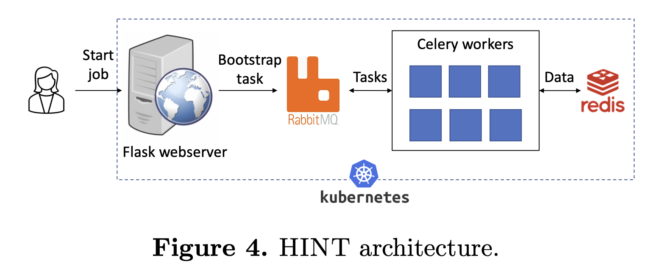
Status
HINT has a scalable architecture (can scale to 50+ nodes) and has fault tolerance
Allows developers to write assertions
Right now, if checks fail then users can correct flakiness
Current Goals
Automating exploration of Trials and only ask users if no trials combination is found
Make real world workflows with large real dataset
Perform evaluation metrics
Future Goals for this Project
Add support for continual learning
Improve scalability

Slide 13
Status (2)
Currently implemented eager trials support in HINT with simple rollback computation that works well for a tree
Added Lazy Trial support
Formalized rollback to next trial problem
Added some unit tests for code.
Working on making a real-world workflow using large real-world dataset
Worked on Card Processing Workflow
Goal is to now work for Industrial quality control workflow and add evaluation metrics

Slide 14
Thank You

Slide 15
Comparison with Constrained Programming
dob = to_date (’08.01.1990’)
if dob.month == ‘August’:
discount=True
doi = datetime.strptime(’13 July 2008’,..).date()
assert doi >= dob.replace(year = dob.year + 18)
Constraint programming is typically run-in isolation
First try 1 August 1990. It fails assertion
Then try 8 January 1990. It passes assertion.
But you also have to rollback and change discount to False and all other transitive side-effects caused by the failed Trial of dob.
Conventional constraint programming does not handle this

